Slide 1

Nafis Ahmad Ibn Abdullah​ | 2010259​
MD Arifinul HoqueChowdhury​ | 2031015​
Samira Binte Khair​ | 2020074​
Mumtahina Arbi​ | 2130152​
Omer Latif​ | 2030586​
Md.Basitullah Khan​ | 2231327​
Database Management System
Group - 17

Slide 2
Table of contents
01
02
System Design
Implementation

Slide 3
01
System Design
As is Rich picture
To be Rich picture
ERD
Schema
Normalization
Data Dictionary

Slide 4
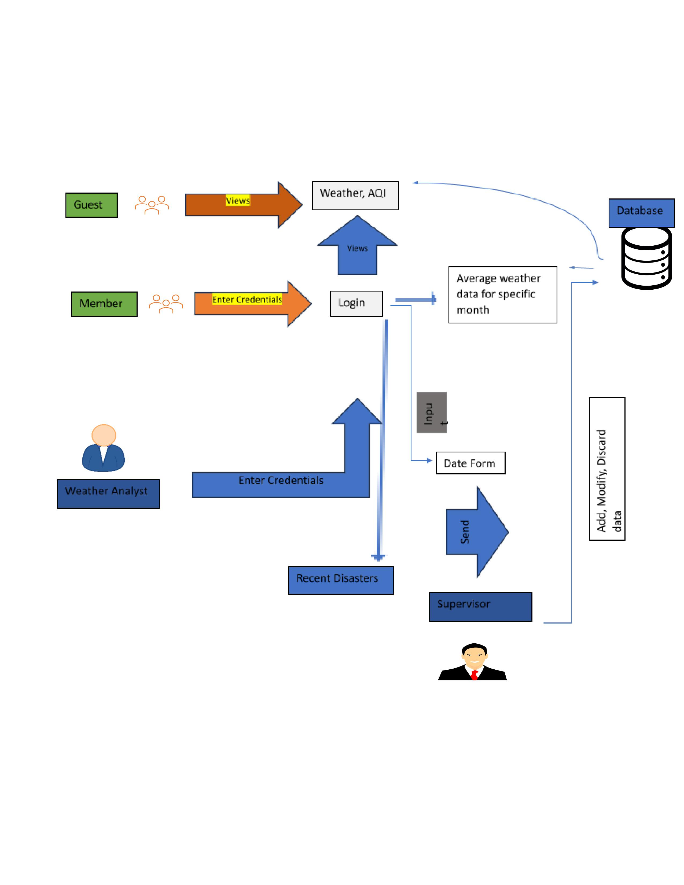
As is Rich Picture

Slide 5
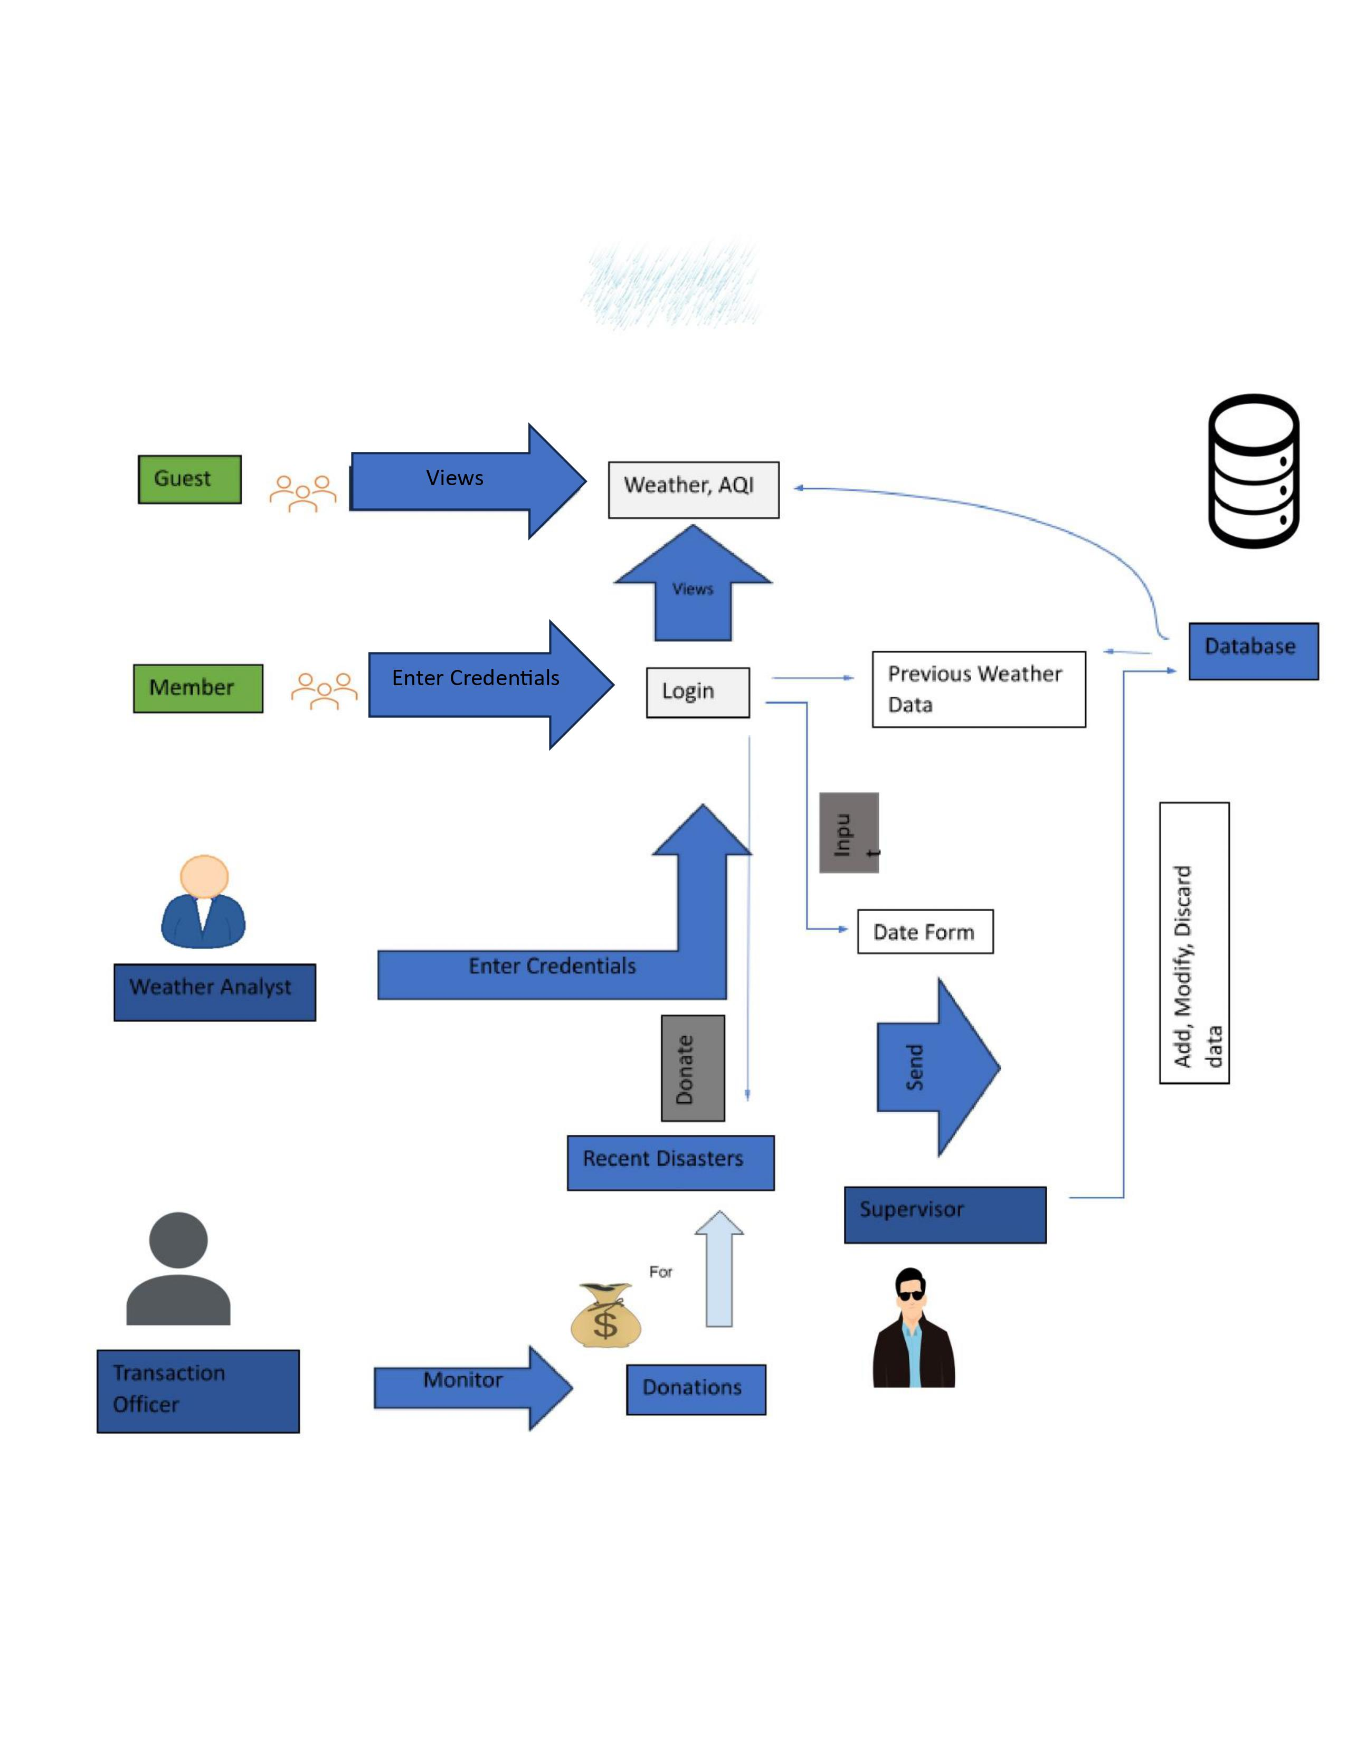
To be Rich Picture
Sticks
Stones
And what we still use to this day:

Slide 6
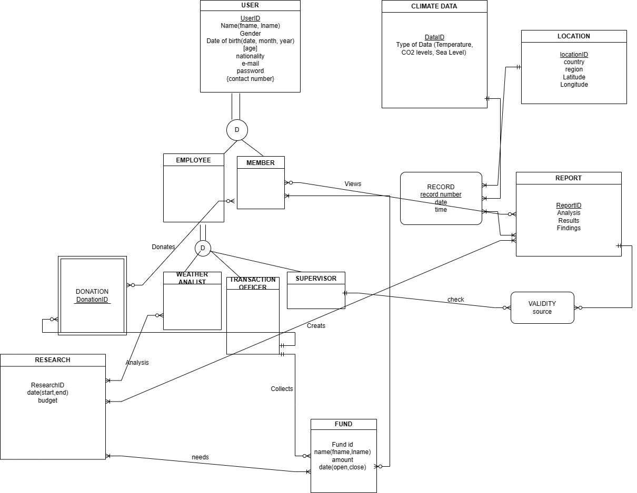
Entity Relationship Diagram
A numbering system is a set of symbols, which have a specific meaning that expresses the quantity of an object as a whole. It also allows you to construct all valid numbers and establish a certain value according to their position
Numbering systems
Egyptian
Roman
Decimal
The system we
use today

Slide 7
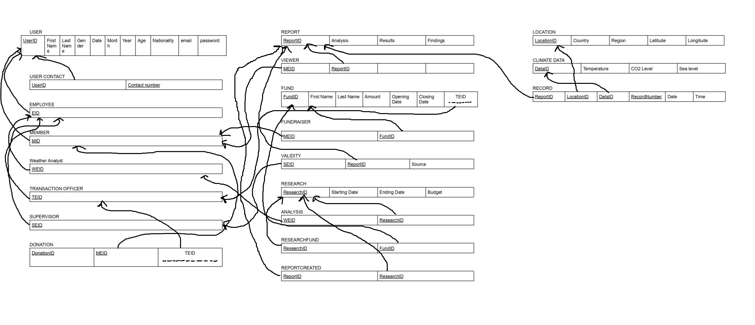
Schema
Why is it a decimal system? Numbers are counted in tens, which is associated with the number of fingers we have on our hands; one of the many ways of counting that we have seen previously
They are divided into groups of ten: units, tens, hundreds, etc.
Why is it an additive system? Each number is represented by a certain symbol, so the value of the numerals is necessary to write a number

Slide 8
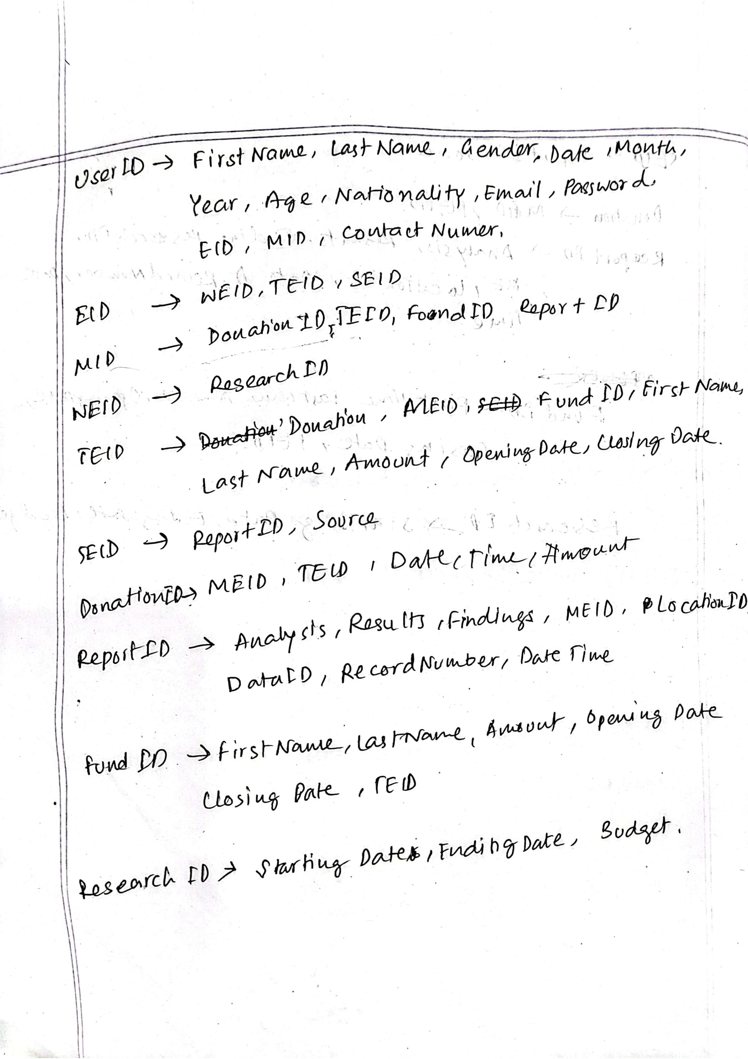
Normalization
Egyptian numbers are represented with different symbols. As it is a NON-positional numbering system, the order in which the symbols are arranged is not important since each symbol has a unique value

Slide 9
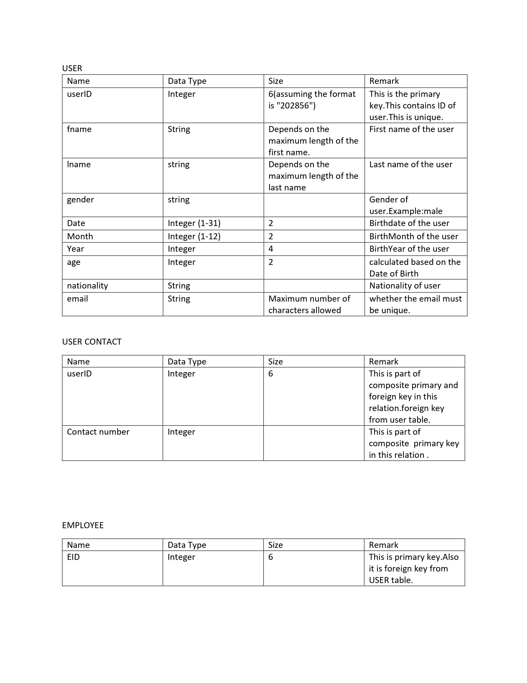
Data Dictionary
Can numbers be represented by letters?

Slide 10
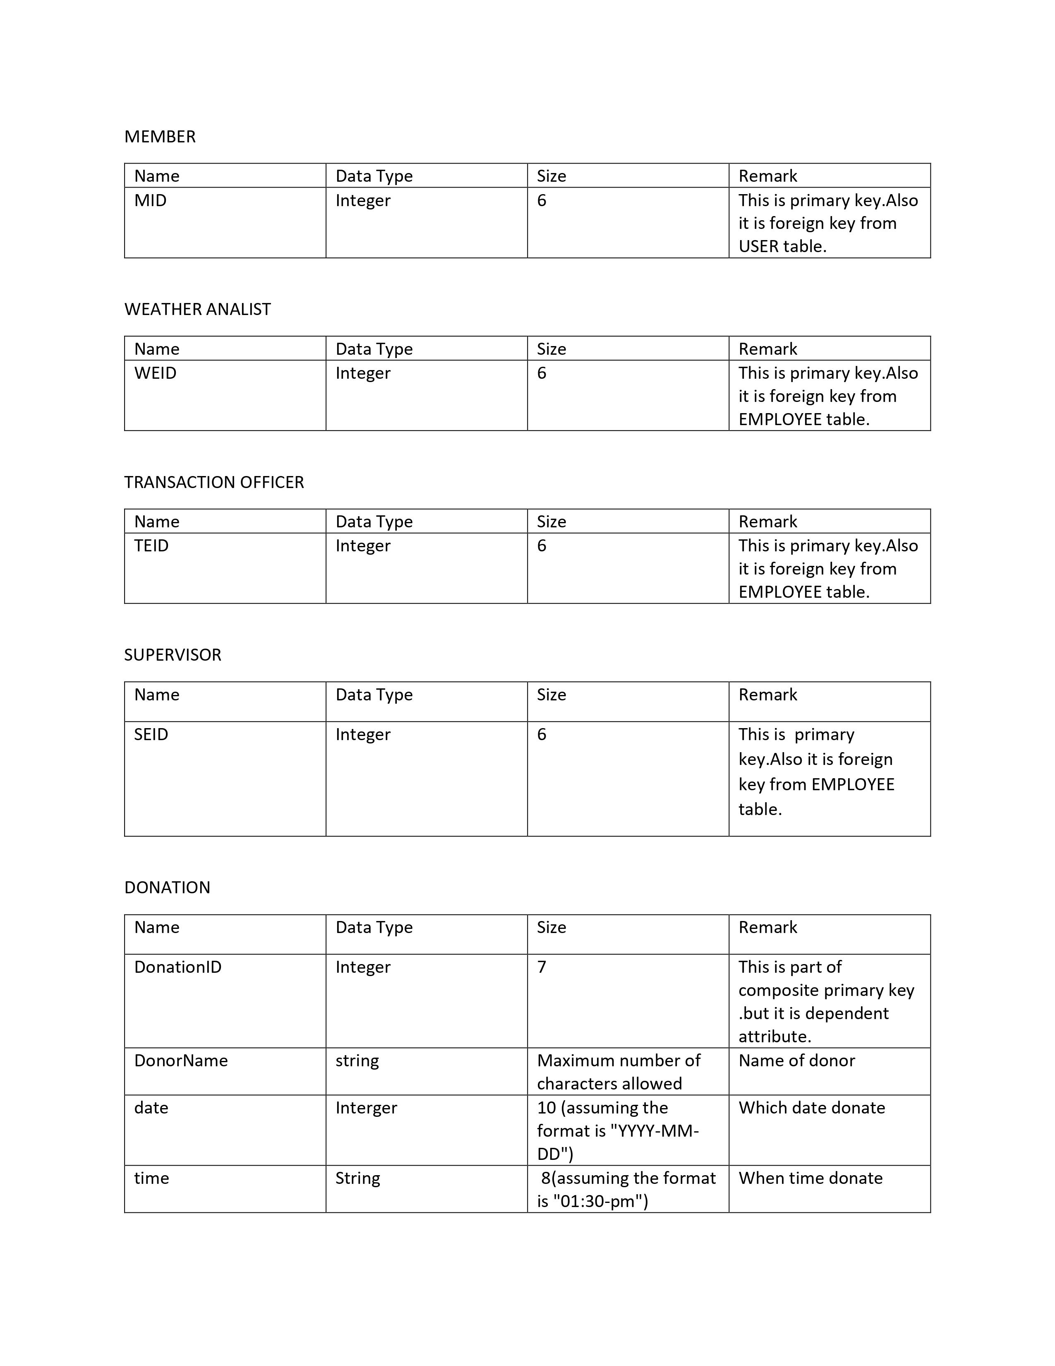

Slide 11
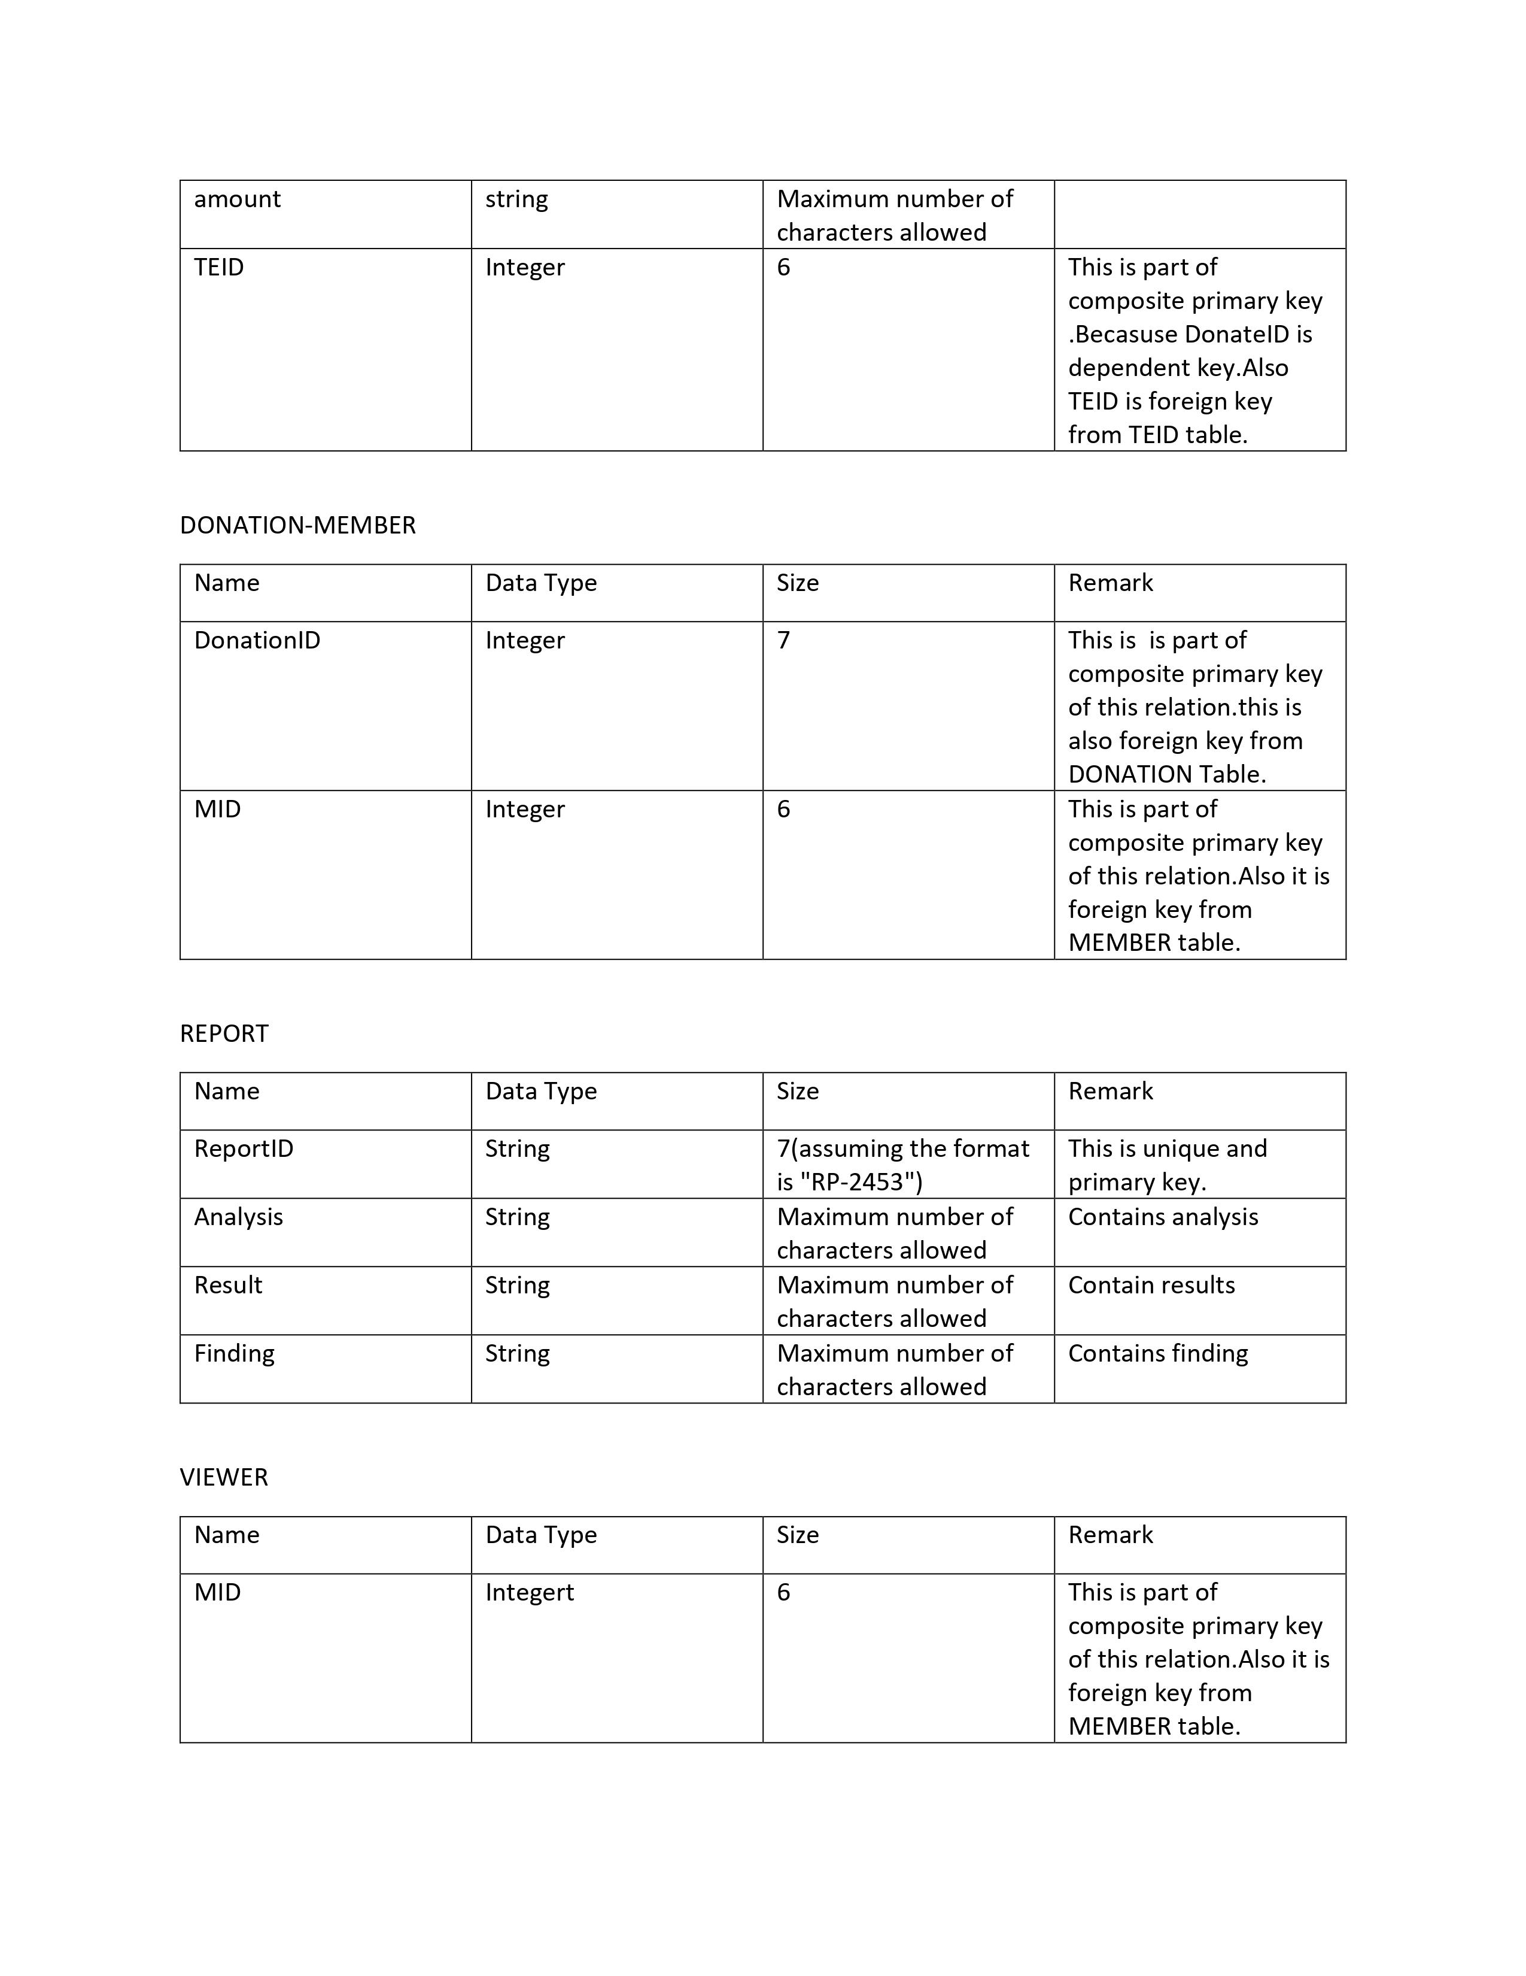

Slide 12
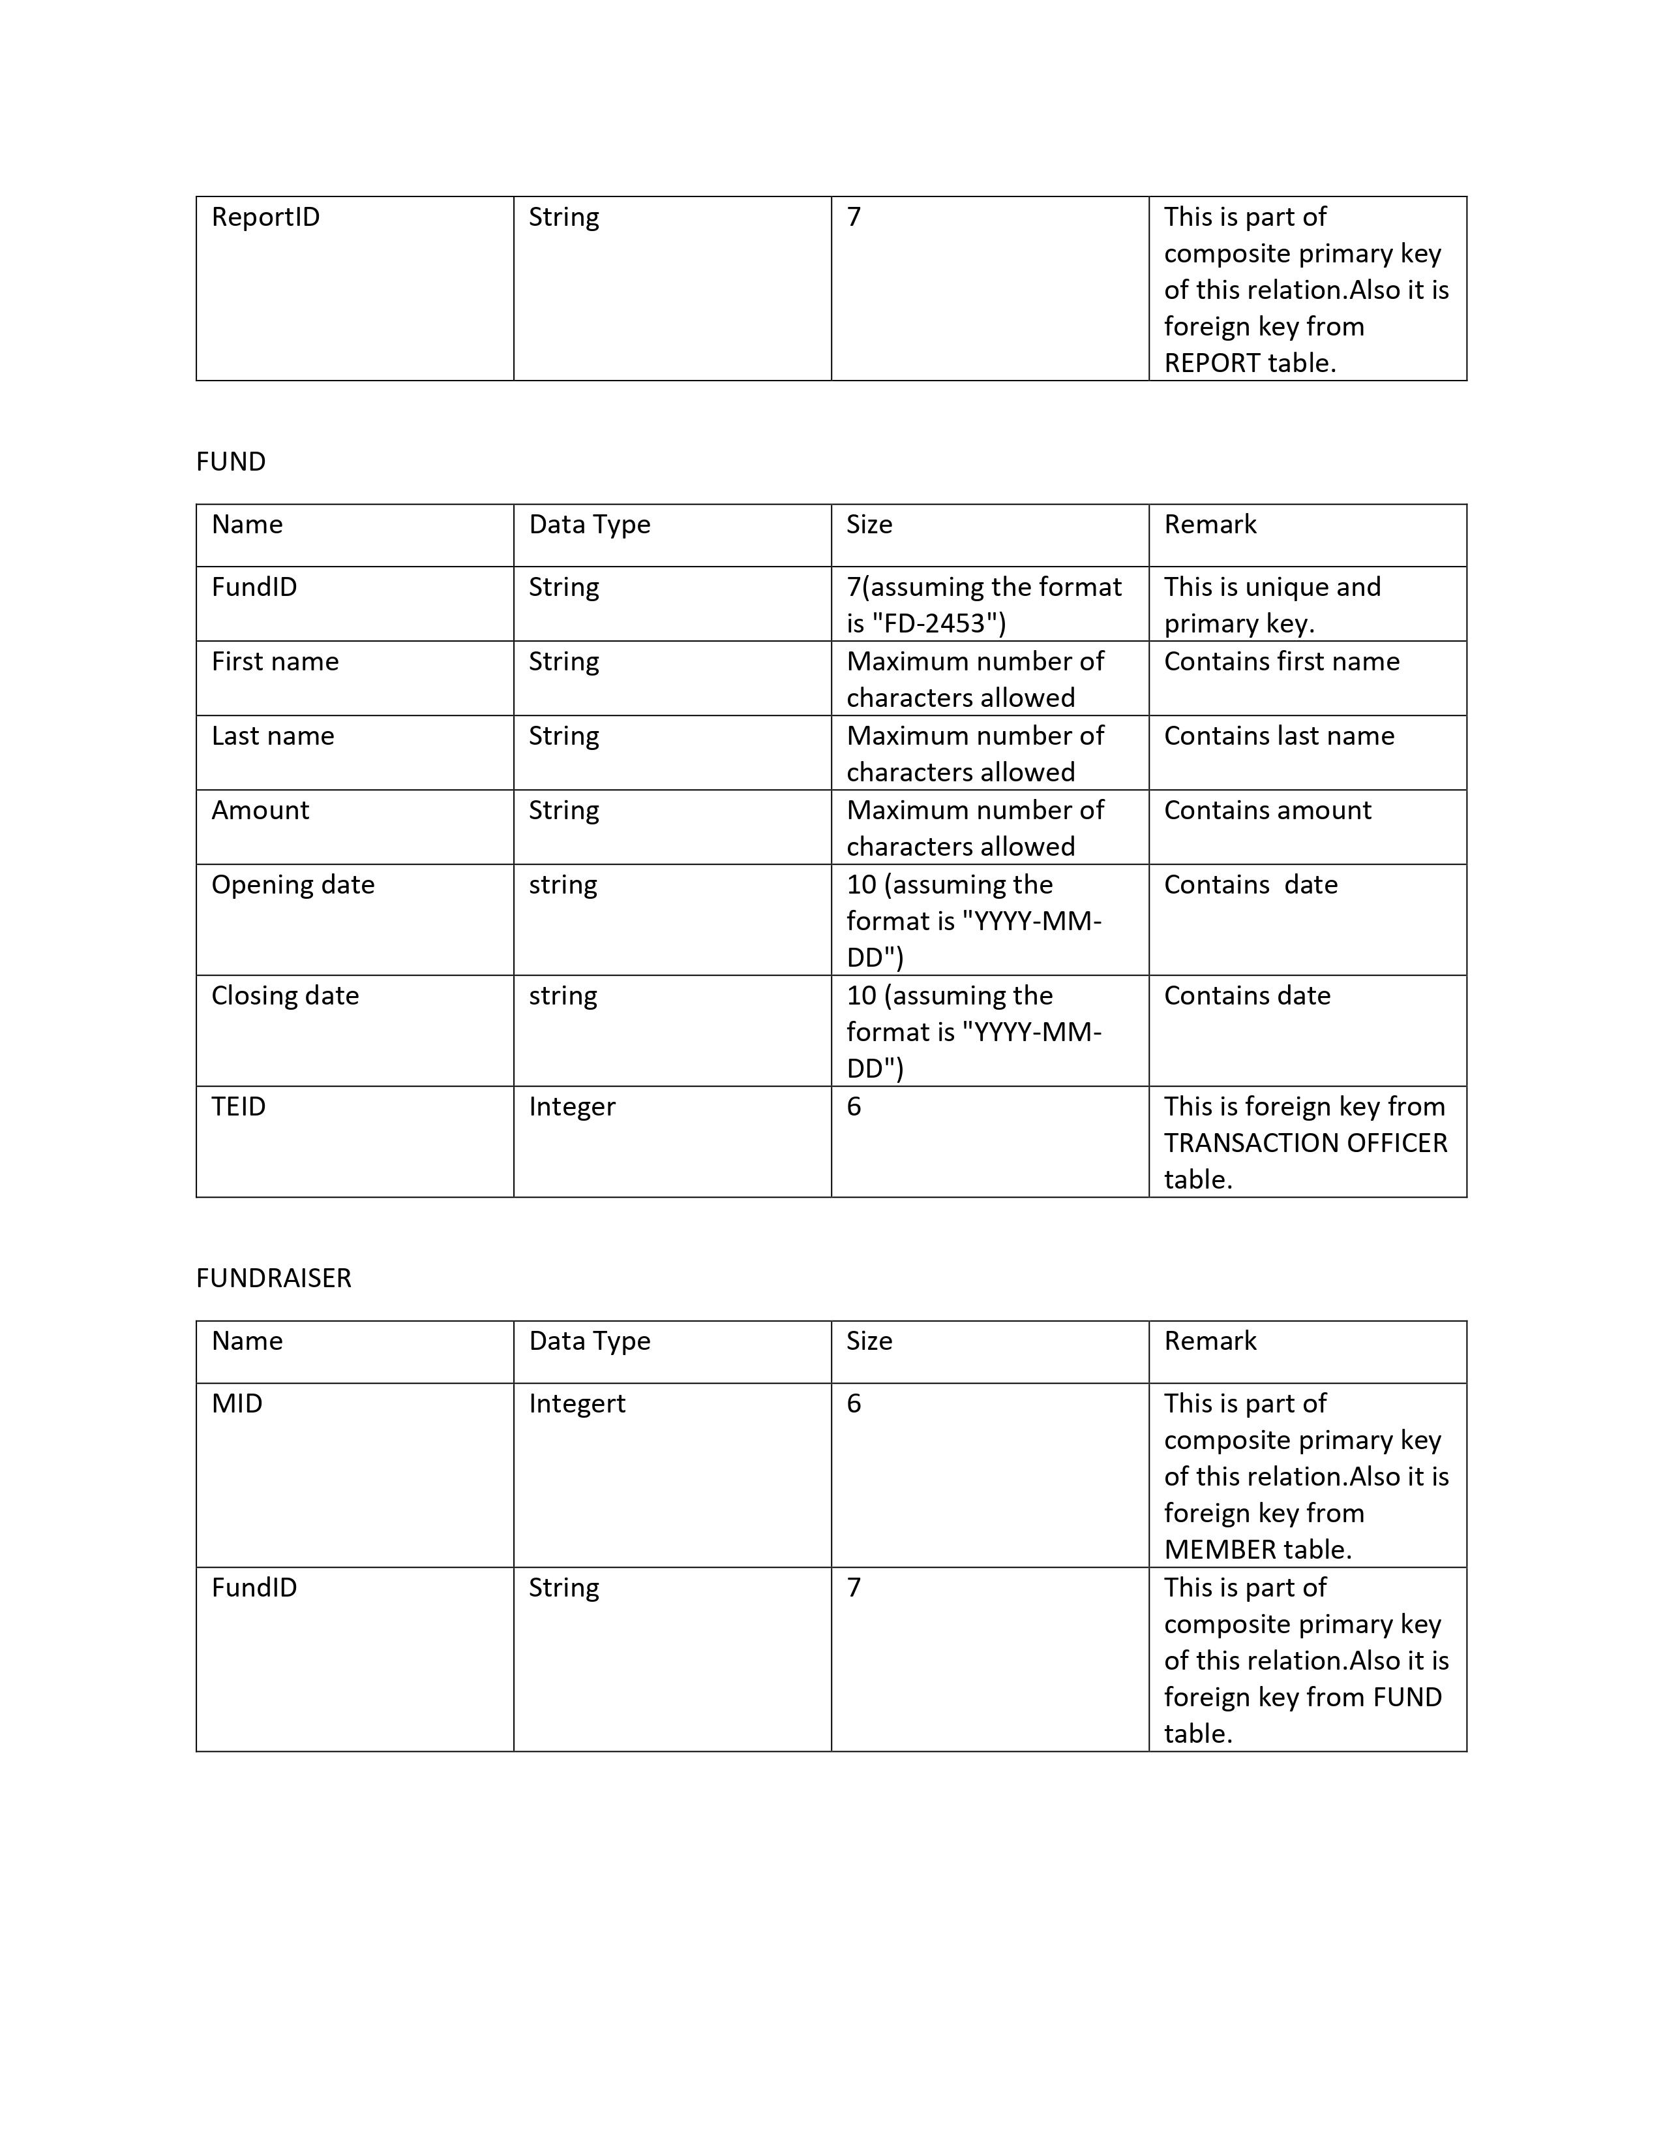

Slide 13
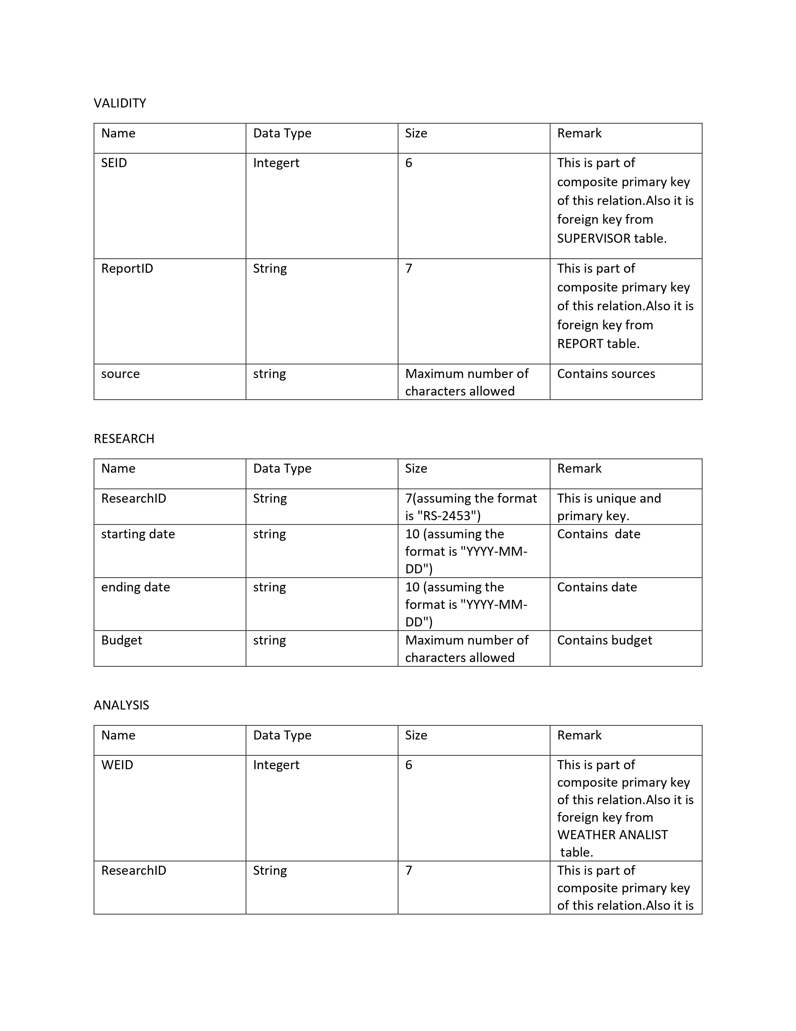

Slide 14
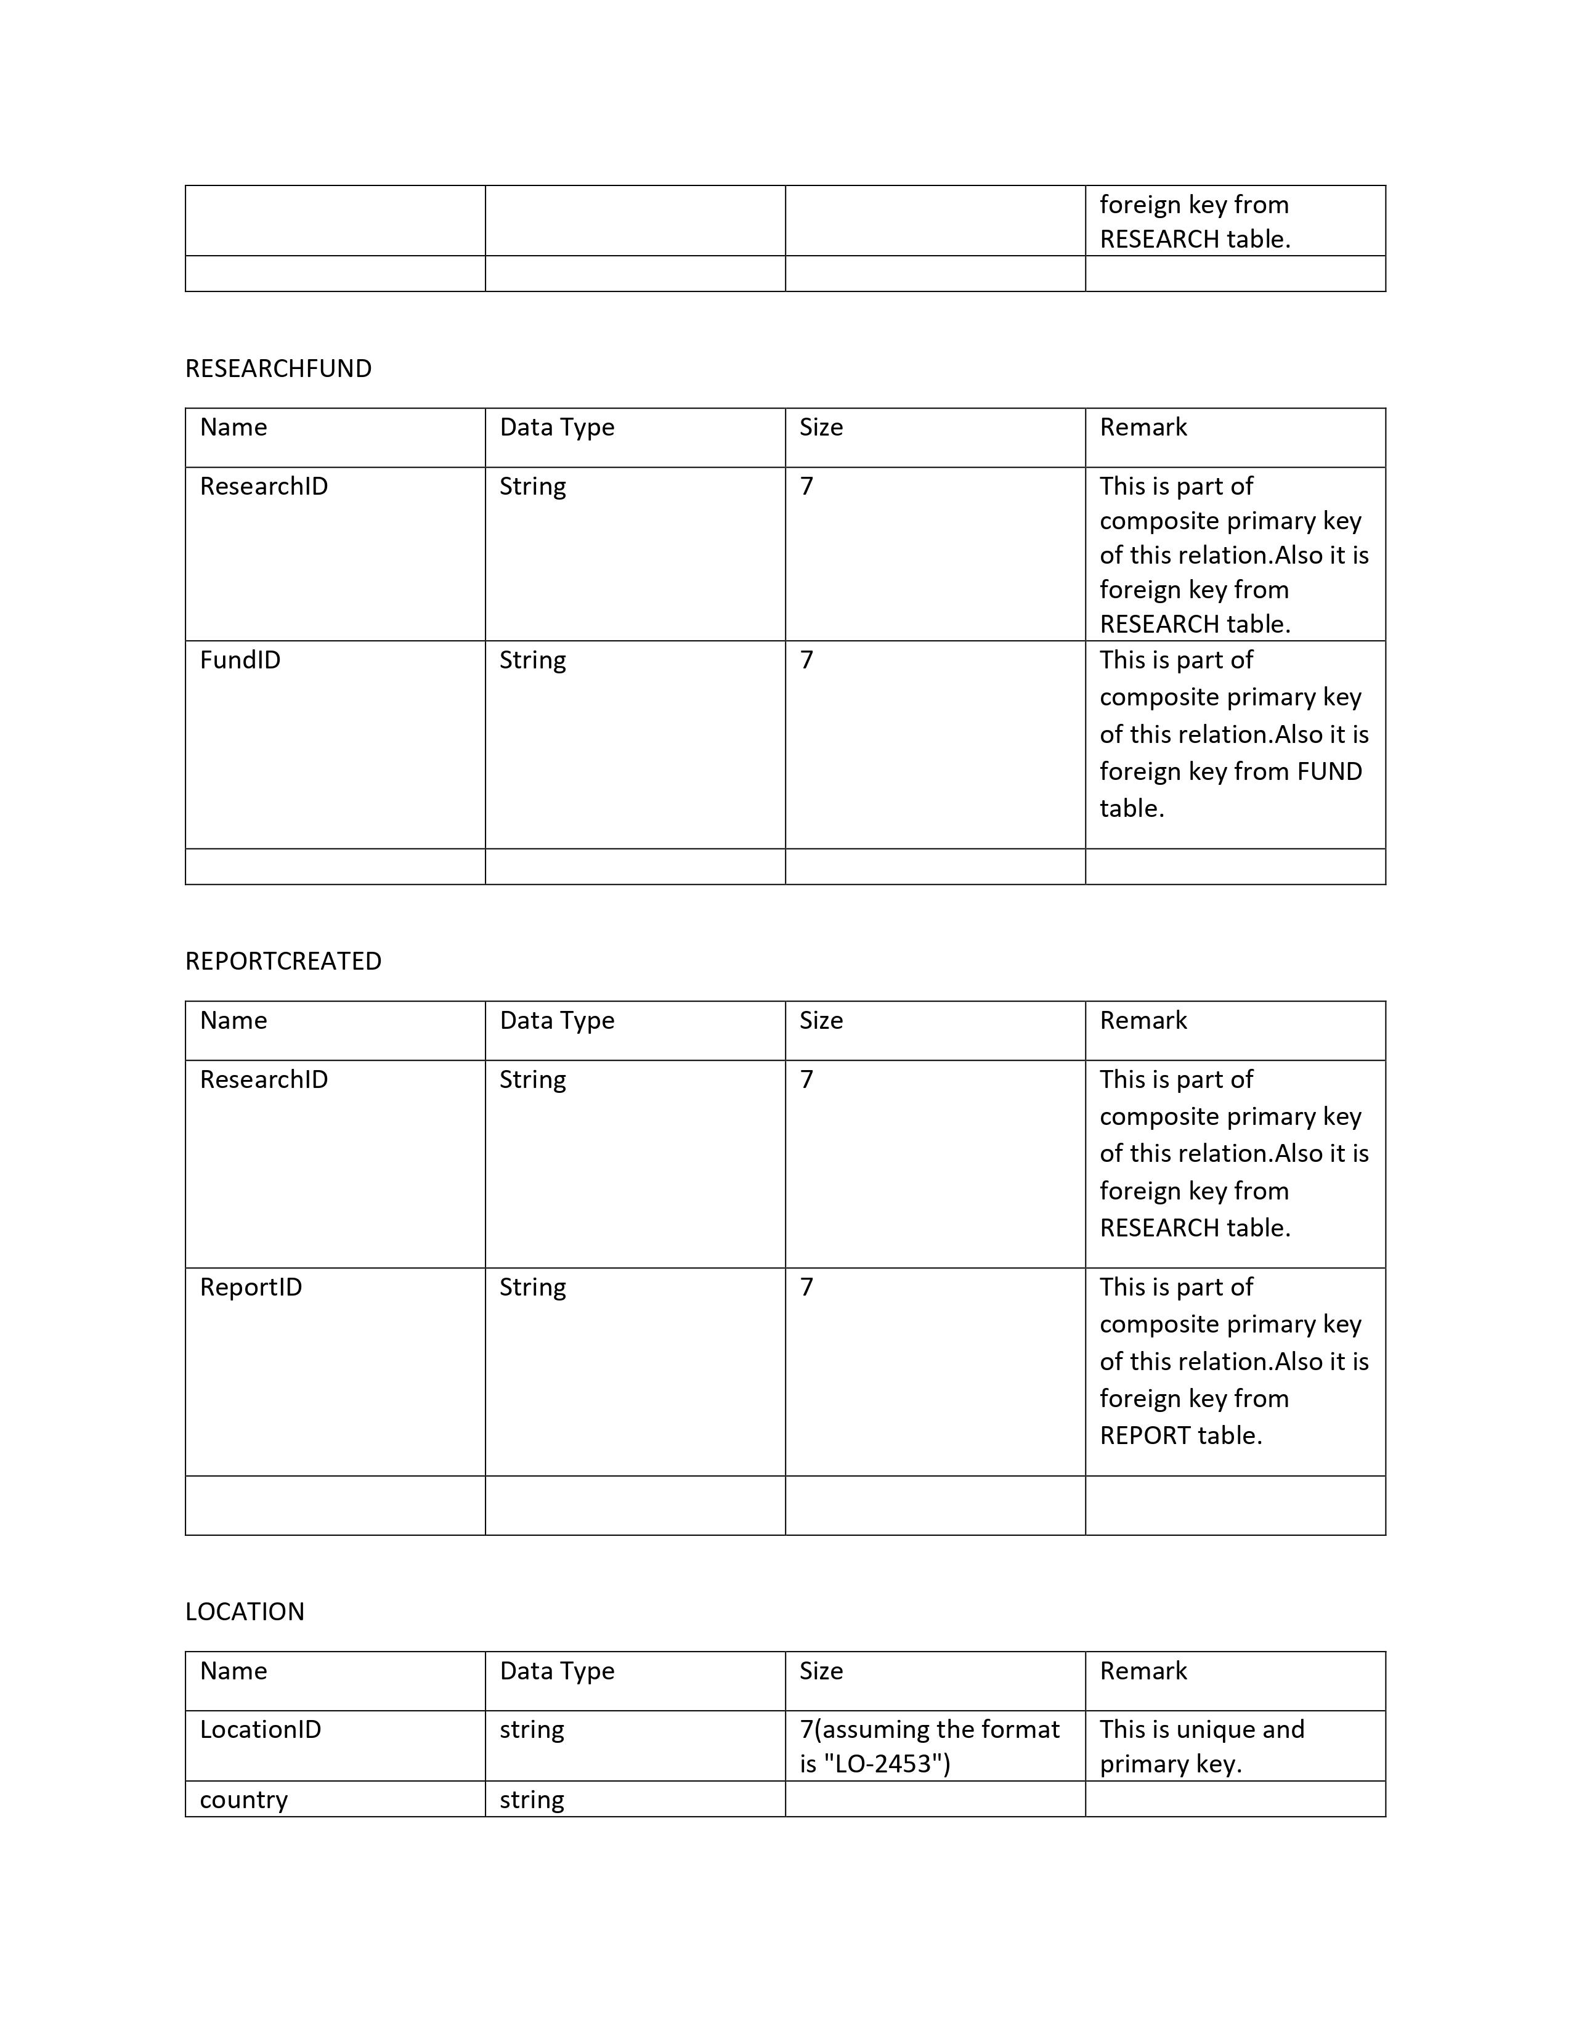

Slide 15
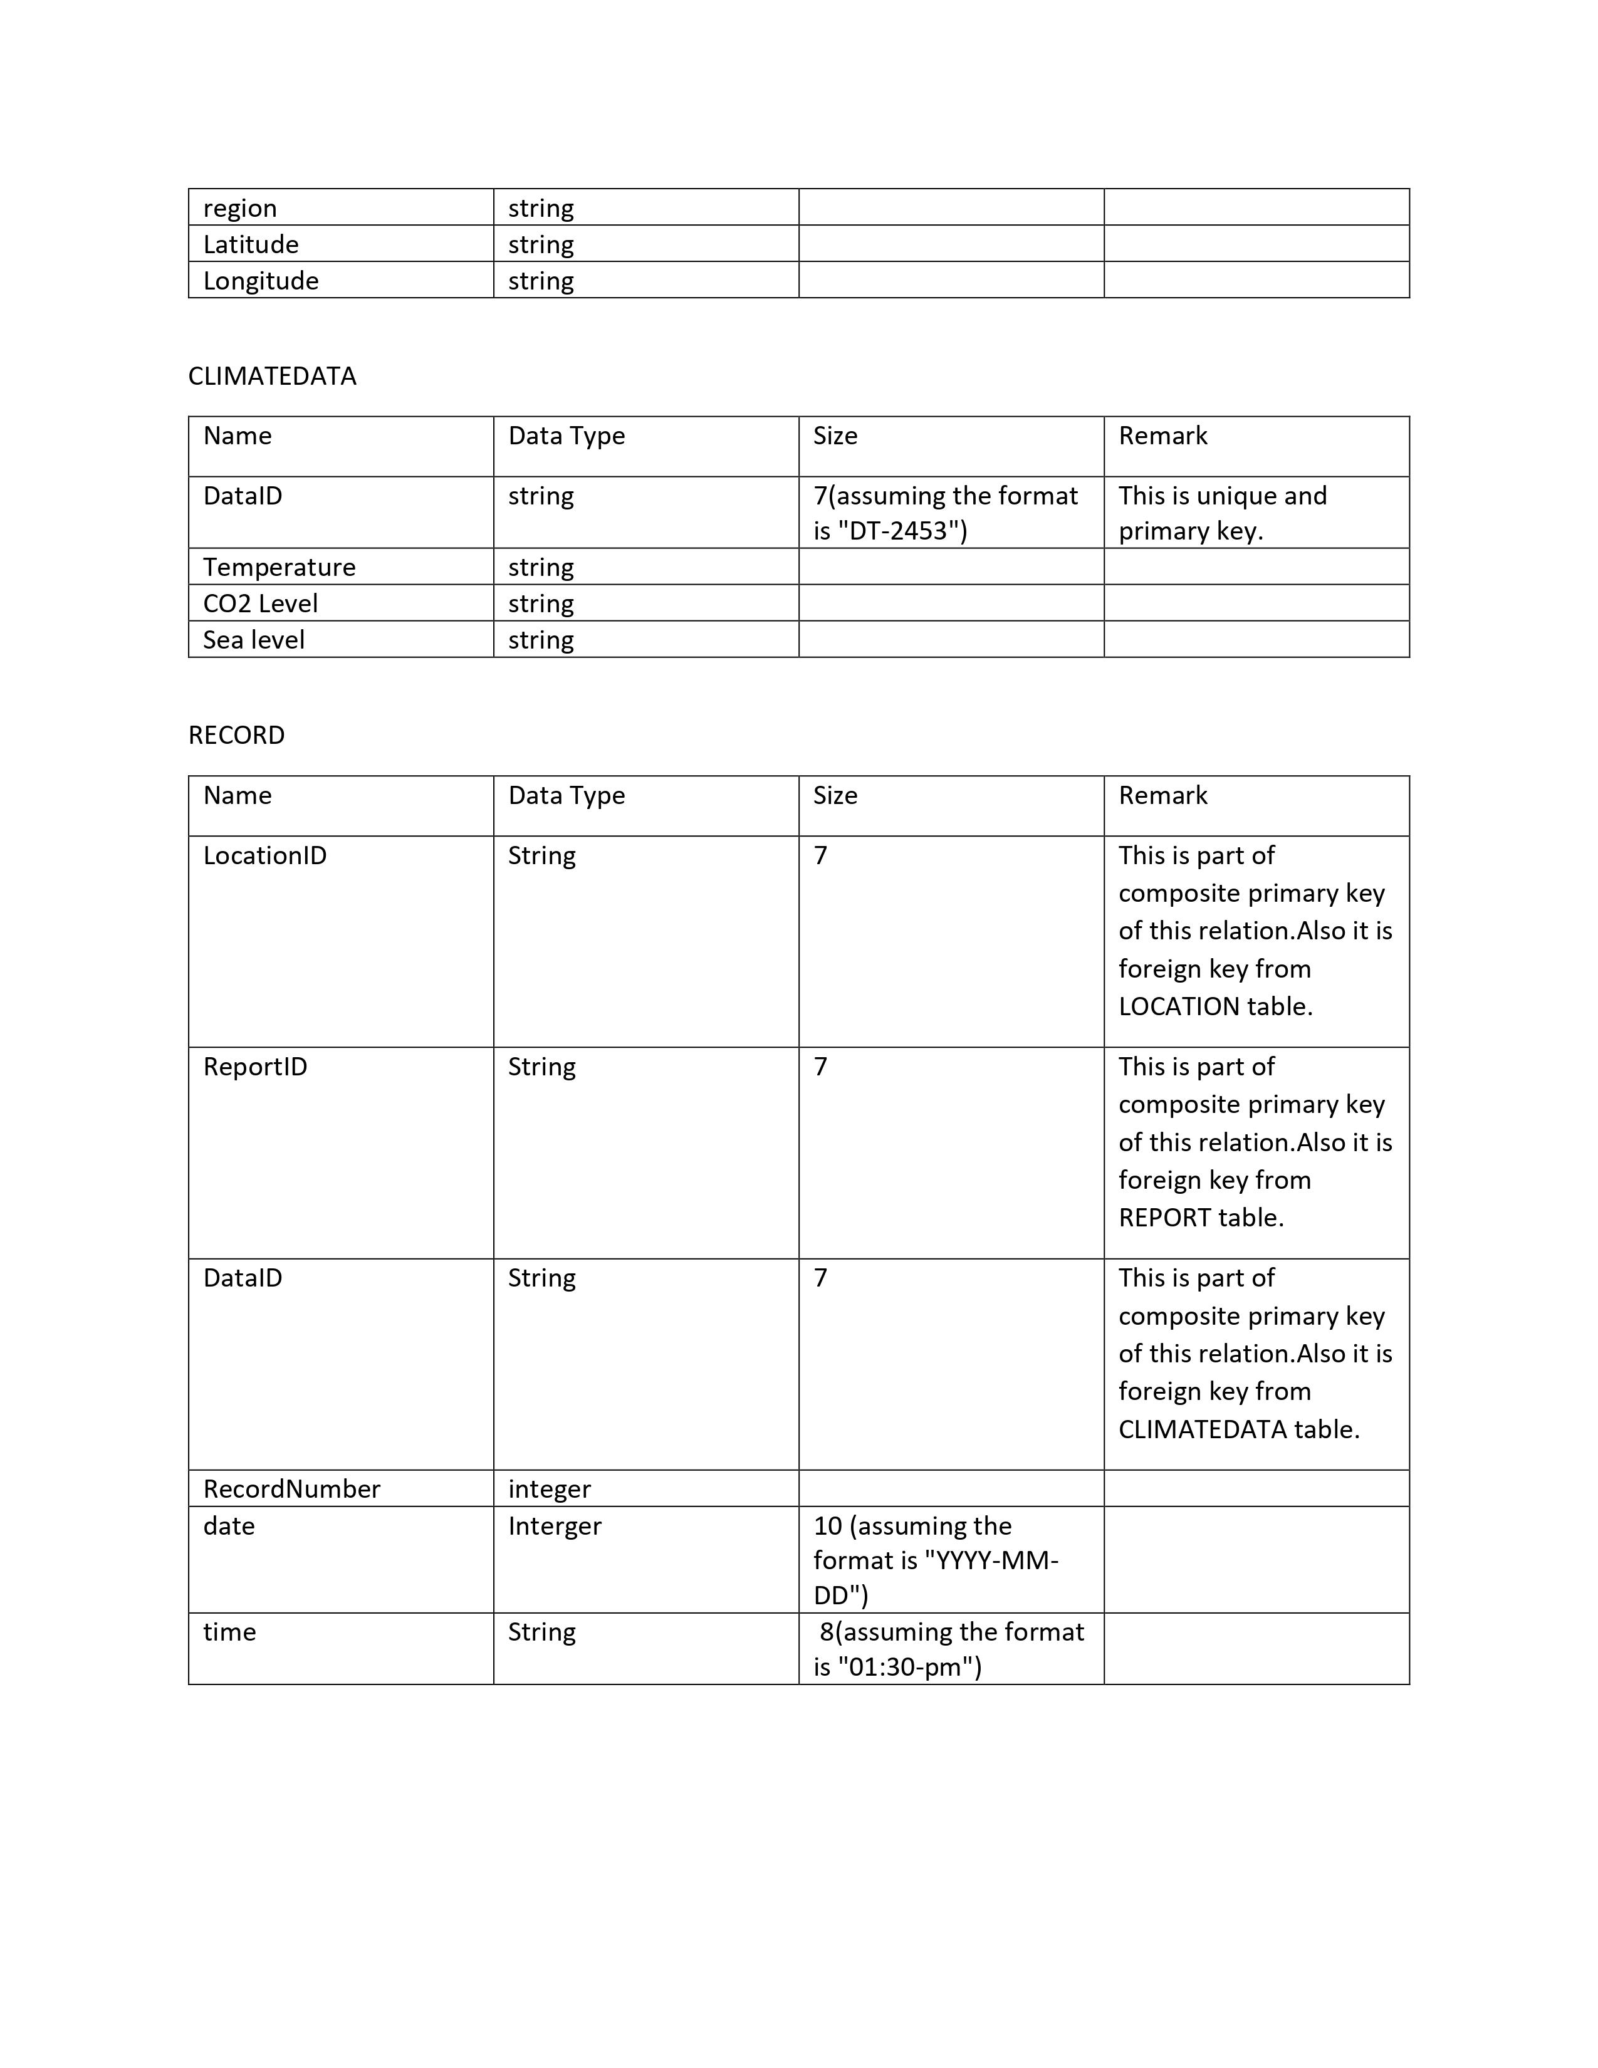

Slide 16
02
Implementation
Front End: HTML, CSS and Java Script
Back End: PHP and MySQL

Slide 17

Login Interface

Slide 18
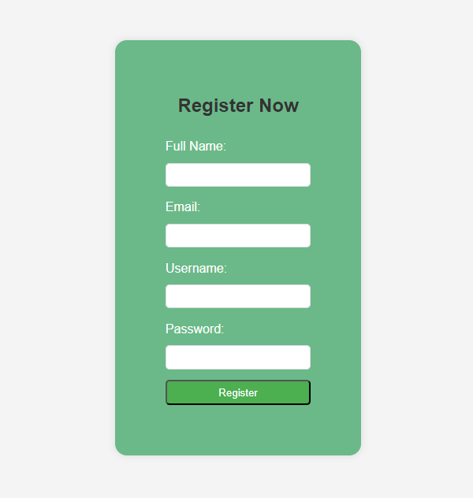

Slide 19
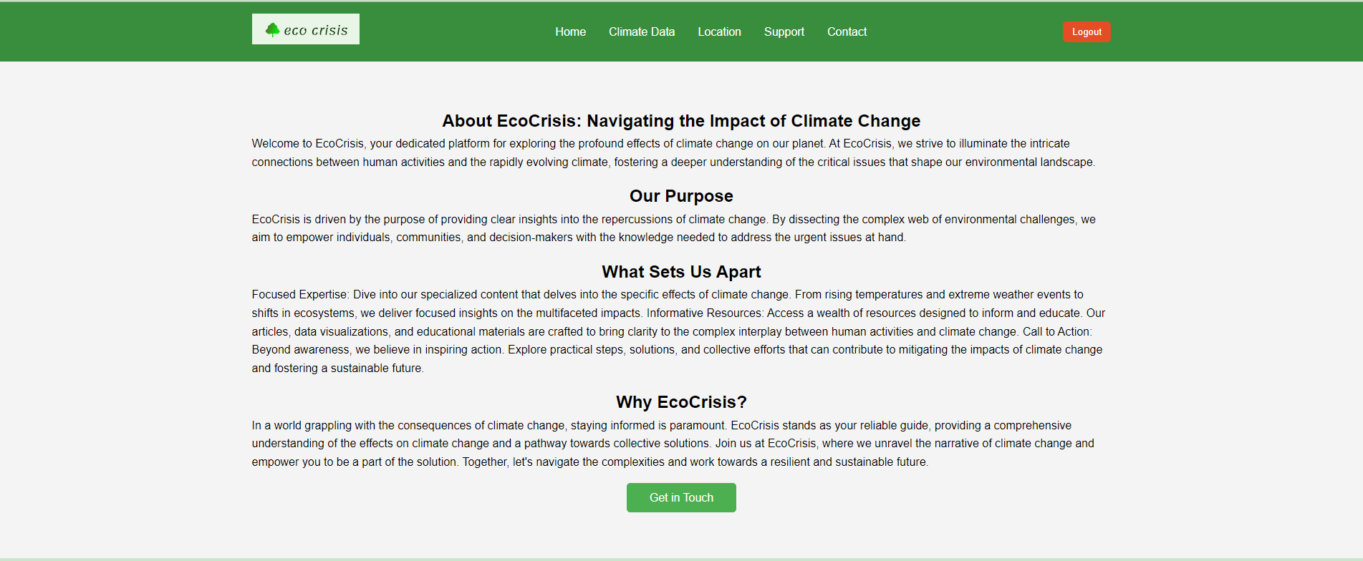
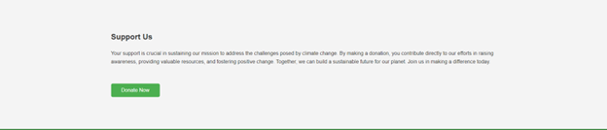
Dashboard

Slide 20
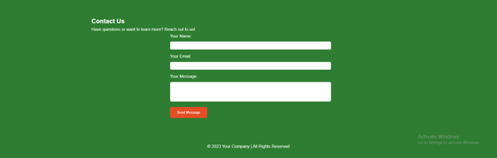
Contact Interface

Slide 21


News Interface

Slide 22
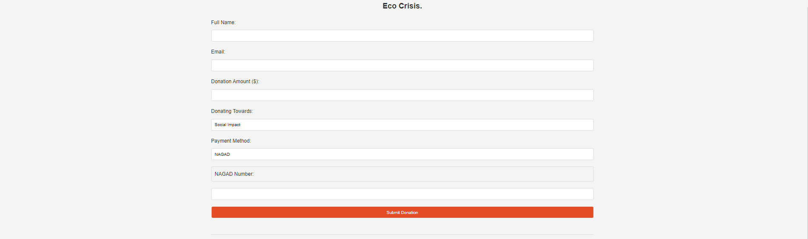
Donation Interface

Slide 23
Thank you

